Slide 1
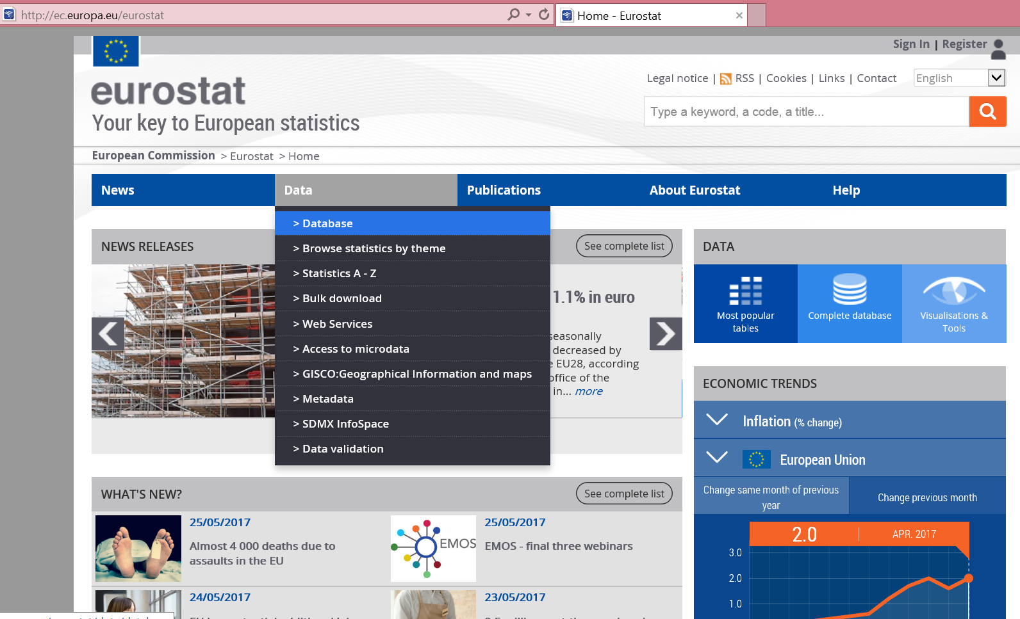
Procedure to obtain Labor Cost Index data in Europe
1. Go to:
2. Move cursor to “Data” and then from the dropdown menu click on “Database”.
ec.europa.eu/eurostat

Slide 2
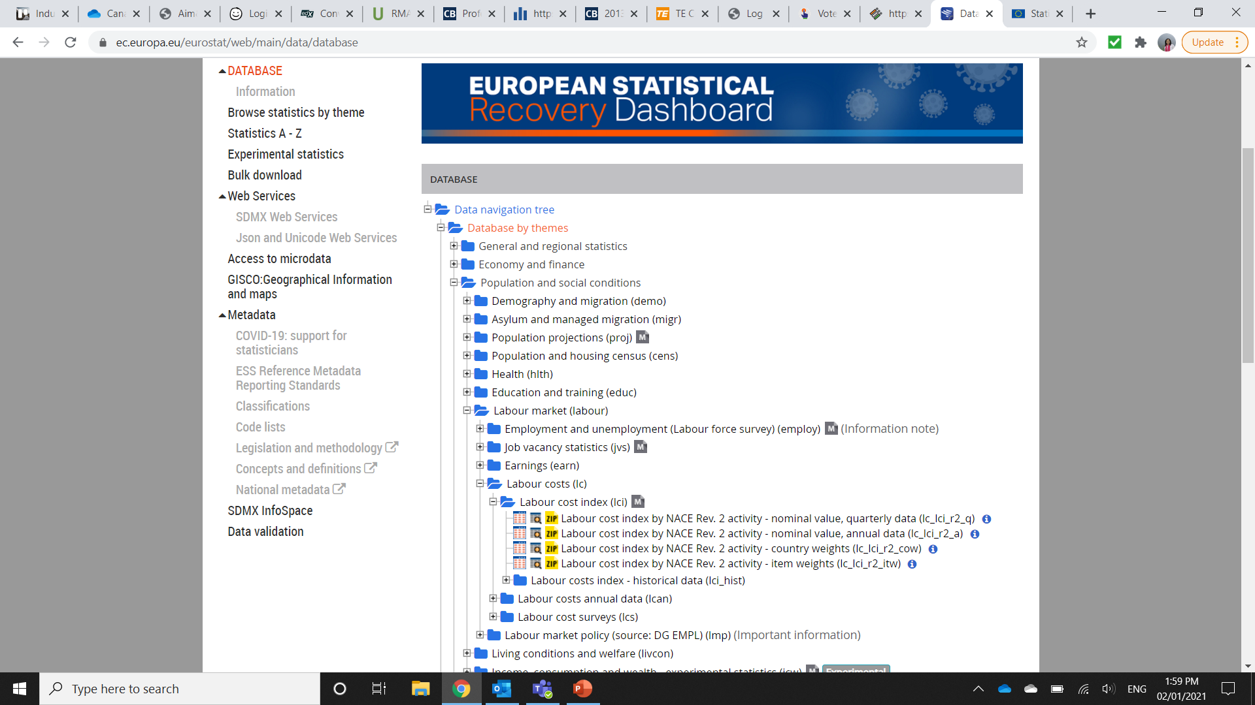
Procedure to obtain Labor Cost Index data in Europe
Under “Tables by themes”:
Select “Population and social conditions”
Select “Labour market”
Select “Labour costs”
Select “Labour cost index (lci)”
Click on the ‘Data Browser’ icon:
preceding “Labour cost index by NACE Rev.2 activity – nominal value, annual data (lc_lci_r2_a)

Slide 3
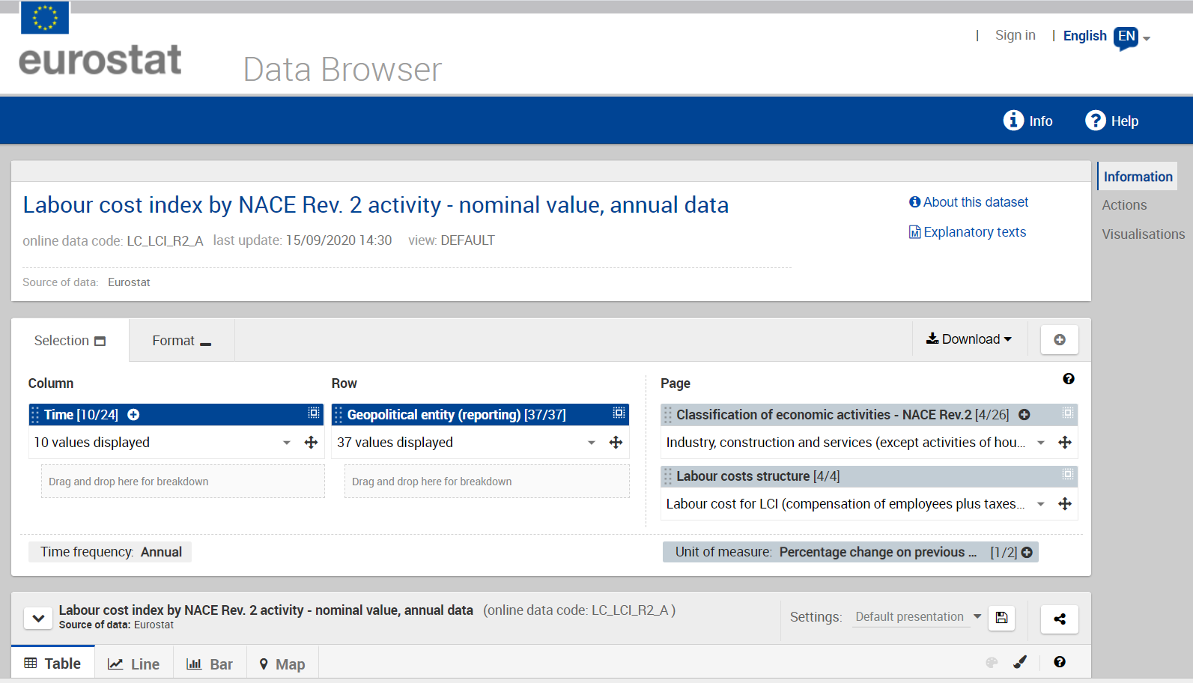
Procedure to obtain Labor Cost Index data in Europe
Click on the “+” sign next to “Unit of measure” tab

Slide 4
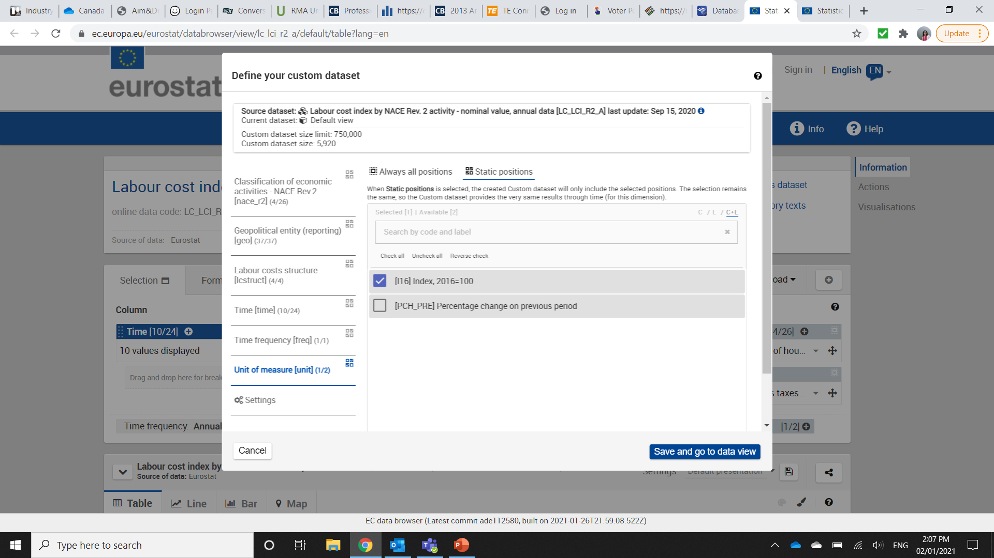
Procedure to obtain Labor Cost Index data in Europe
Select “Index, 2016=100”
Click on “Save and go to data view”

Slide 5
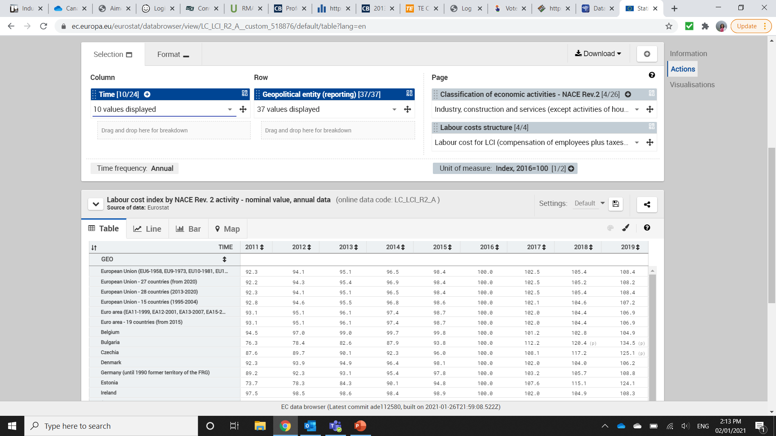
Procedure to obtain Labor Cost Index data in Europe
The labor cost index data is presented in a table

Slide 6
Procedure to obtain Labor Cost Index data in Europe
You can select a specific industry sector by clicking on the “+” sign next to Classification of Economic Activities – NACE Rev.2
To choose an industry, make appropriate selection in the pop-up window
Click “Save and go to data view”

Slide 7
Procedure to obtain Labor Cost Index data in Europe
To customize the data table (for example to select only one country, or change the time period) click on appropriate filters above

Slide 8
Procedure to obtain Labor Cost Index data in Europe
To download the data in Excel click on the “Download” tab

